Slide 1
101009/IT422T DESIGN AND ANALYSIS OF ALGORITHM LAB

Slide 2
Time Space Trade off Implementation
Let S be an integer array of n elements perform two operations
remove(i)-I is removed from S
next(i)- returns the next larger element j, where j>i, jε S, if such j exists. Implement the same using linked list.
Make observations on the two methods and comment on time-space tradeoff

Slide 3
clock_t clock(void)
C library function clock_t clock(void) returns the number of clock ticks elapsed since the program was launched.
To get the number of seconds used by the CPU, you will need to divide by CLOCKS_PER_SEC.

Slide 4
Example Program
#include <time.h>
#include <stdio.h>
int main () {
clock_t start_t, end_t;
double total_t;
int i;
start_t = clock();
printf("Starting of the program, start_t = %ld\n", start_t);
printf("Going to scan a big loop, start_t = %ld\n", start_t);
for(i=0; i< 10000000; i++) {
}
end_t = clock();
printf("End of the big loop, end_t = %ld\n", end_t);
total_t = (double)(end_t - start_t) / CLOCKS_PER_SEC;
printf("Total time taken by CPU: %f\n", total_t );
printf("Exiting of the program...\n");
return(0);
}
OUTPUT
Starting of the program, start_t = 1194
Going to scan a big loop, start_t = 1194
End of the big loop, end_t = 26796
Total time taken by CPU: 0.025602
Exiting of the program...

Slide 5
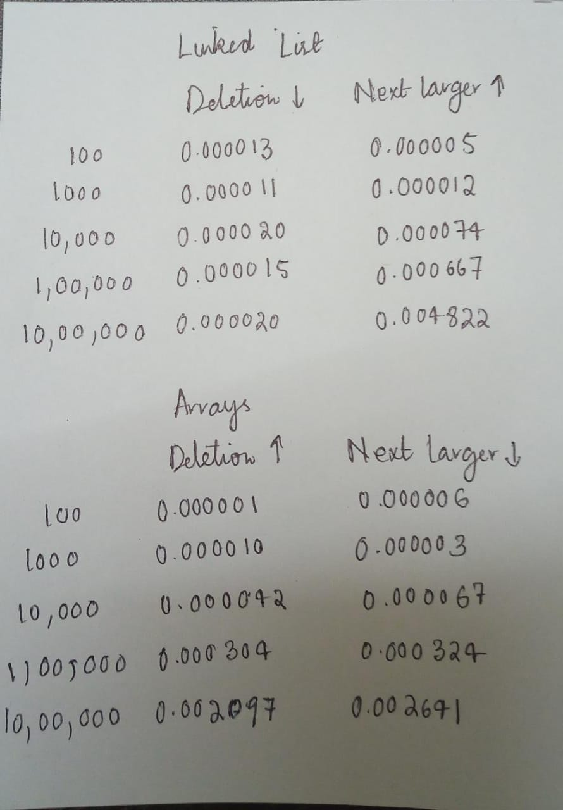
Expected output of program 1

Slide 6
For Deletion
Input Size (n) | Time taken for LL (in sec) | Time taken for Arrays(in sec)
…..
For Finding the next largest
Input Size (n) | Time taken for LL(in sec) | Time taken for Arrays(in sec)
……..

